Slide 1
Basic Concepts of Information Technology

Slide 2
Information Technology :-
"Information technology (IT) is a technology which uses computers to gather, process, store, protect, and transfer information. Today, it is common to use the term Information and communications technology (ICT) because it is unimaginable to work on a computer which is not connected to the network."

Slide 3
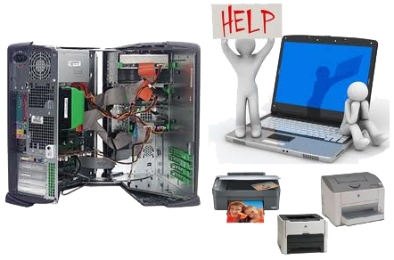
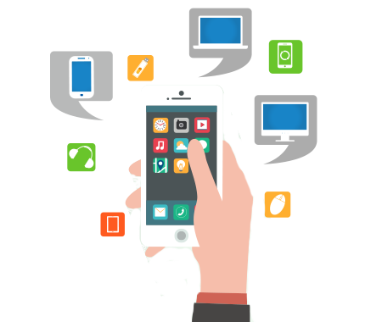
The computer consists of
1, Hardware
2,software

Slide 4
Lesson 1 Information Technology
Hardware
A computer system consists of two major elements: hardware and software. Computer hardware is the collection of all the parts you can physically touch. Computer software, on the other hand, is not something you can touch. Software is a set of instructions for a computer to perform specific operations. You need both hardware and software for a computer system to work. Some hardware components are easy to recognize, such as the computer case, keyboard, and monitor. However, there are many different types of hardware components. In this lesson, you will learn how to recognize the different components and what they do.

Slide 5
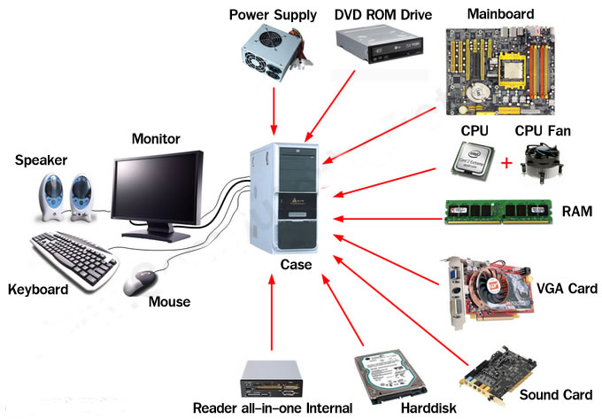
Lesson 1 Information Technology
Hardware Parts

Slide 6
Lesson 1 - Information Technology
Software
  Software is a program that enables a computer to perform a specific task, as opposed to the physical components of the system (hardware).
  Computer software is programming code executed on a computer processor. The code can be machine-level code, or code written for an operating system. An operating system is software intended to provide a predictable and dependable layer for other programmers to build other software on, which are known as applications. It also provides a dependable layer for hardware manufacturers.

Slide 7
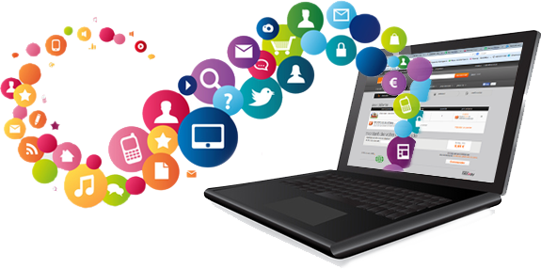
Lesson 1 - Information Technology
This standardization creates an efficient environment for programmers to create smaller programs, which can be run by millions of computers. Software can also be thought of as an expression that contrasts with hardware. The physical components of a computer are the hardware; the digital programs running on the hardware are the software. Software can also be updated or replaced much easier than hardware. Additionally, software can be distributed to a number of hardware receivers. Basically, software is the computer logic computer users interact with.

Slide 8

Lesson 1 – Information Technology

